Slide 1
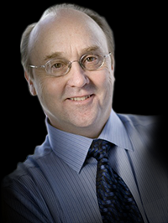
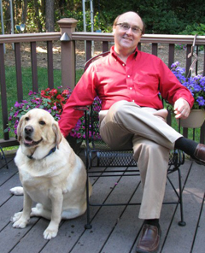
Hello!

Slide 2
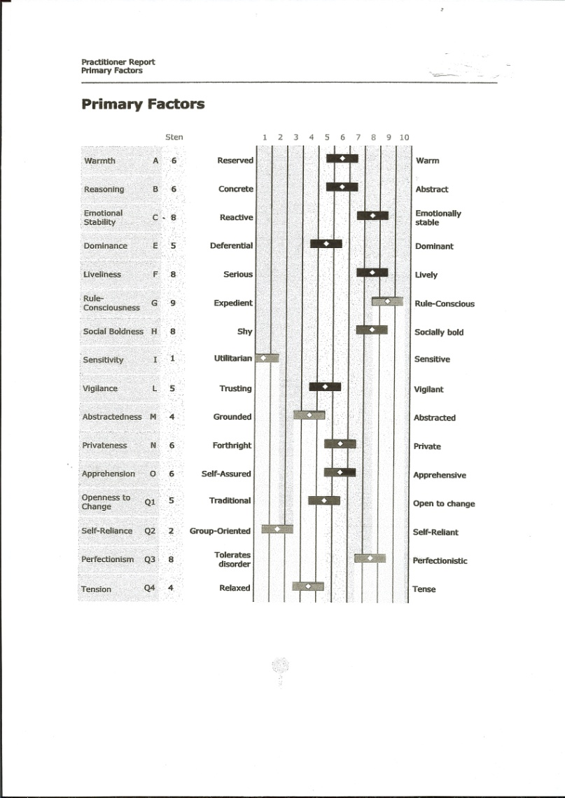
l6 PT Personality Profile

Slide 3
Easy
Time & Cost Efficient

Slide 4
Dr. Victor Rebman, Ph.D.
Licensed Psychologist of
Rebman Consulting

Slide 5
I have over 30 years of experience in the area of assessment and human factors consultation.

Slide 6
Free Tele-consult!

Slide 7
Direct & Personal Your hiring needs are my top priority!

Slide 8
High Quality
Reliable
Cost Efficient
Free Tele-consult (optional)

Slide 9
Every new hire should move your organization forward!
LOOK FOR
Core Motivations
Character Strengths

Slide 10
Most organizations do the opposite! Do NOT hire based only on:
Education
Credentials

Slide 11
The
Bottom
Line
Hire by design. Not by chemistry!

Slide 13
What type of information can you expect to receive?
Information on critical thinking skills of the individual. How well do they…
Avoid miscalculations and costly errors of judgment
Find cost savings other miss
Process new information faster
Make better decisions under pressure

Slide 14
l6 PF Personality Profile Assesses…
Interpersonal skills
Sensitivity to others
Emotional intelligence
Stress coping skills
Thinking style
Openness to change
Emotional stability
Emotional flexibility
Levels of assertiveness
Group Oriented vs. Self-reliant
Ability to make tough decisions
An eye for detail
Creative problem solving
Self-confidence
Rule-consciousness
Leadership potential
Decision Making style
And MORE…
This assessment is one of the most reliable and valued personality profiles available!

Slide 15
But wait…There’s more!! Also Included…
Summary of candidates strengths and vulnerabilities, so you can accurately assess how your candidate will…
fit with your organizations culture
mesh with your existing employees
measure up to the critical factors necessary for success in the position for which they are being considered
You give me the critical factors and I’ll tell you how your candidate measures up!!

Slide 16
The 16 PF Personality Profile allows you to ENHANCE your ability to make good hiring decisions and further coach your employee!

Slide 17
We can do Selection Assessments in all Areas
Sales
IT
Middle Management
VP Positions
Leadership
Executive Profiles
YOU NAME IT! WE CAN DO IT!

Slide 18
The
Bottom
Line
You can dramatically ENHANCE your hiring success saving yourself and your organization tens, hundreds, thousands of dollars!!

Slide 19
Are you excited?? If so… Please, request a sample report!!

Slide 20
Don’t let hiring be a huge stressor at your organization!
Review a sample of our 16 PF selection assessments and we know you will be satisfied!

Slide 21
Call Me!
Thank you for your interest!
Dr. Victor Rebman, Ph.D.
Licensed Psychologist of
Rebman Consulting

